Slide 1
YouSound
Sprint 4 Review

Slide 2
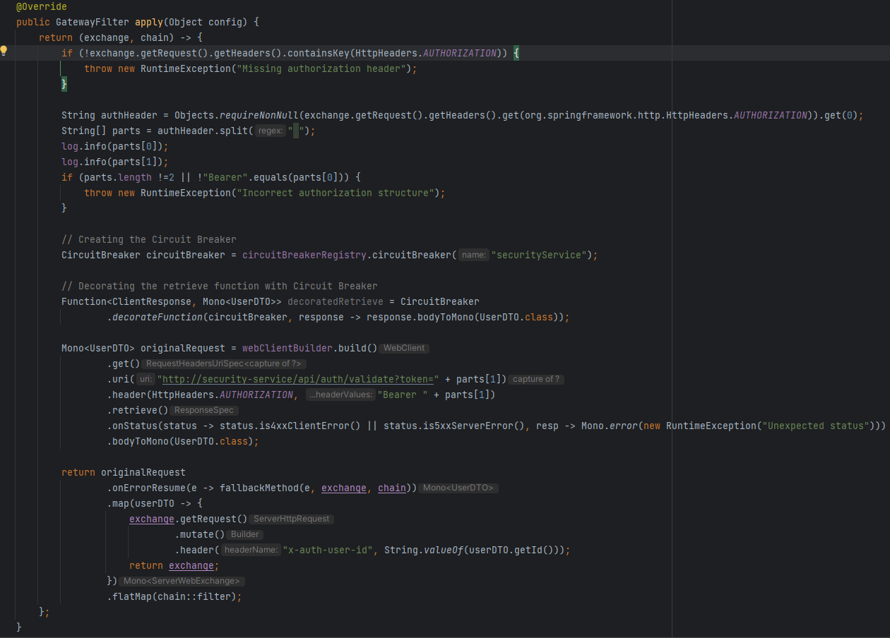
Gateway Filter

Slide 3
Implementation
During this sprint, I implemented features such as:
- Search music content
- View/Change Profile Information
- Admin Dashboard (Music, Users)
- Artist Home
- Upload music

Slide 4


Slide 5
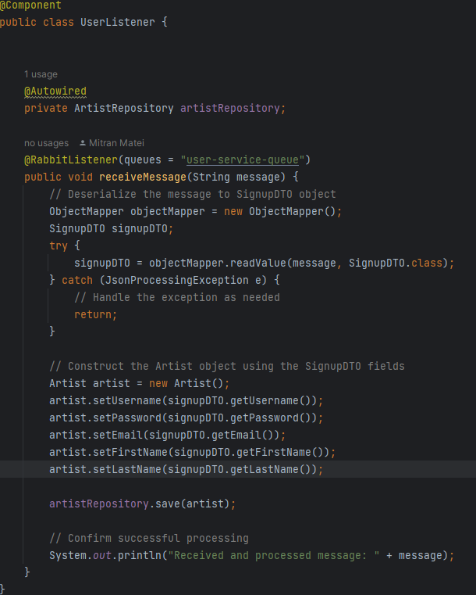
Message Broker

Slide 6
JMeter
The JMeter tests I setup are:
Load Tests
Spike Tests
Endurance Tests
Stress Tests

Slide 7
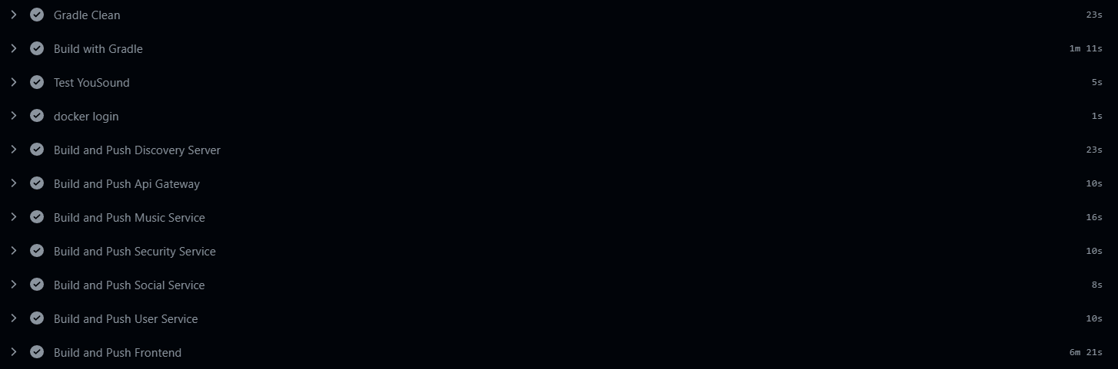
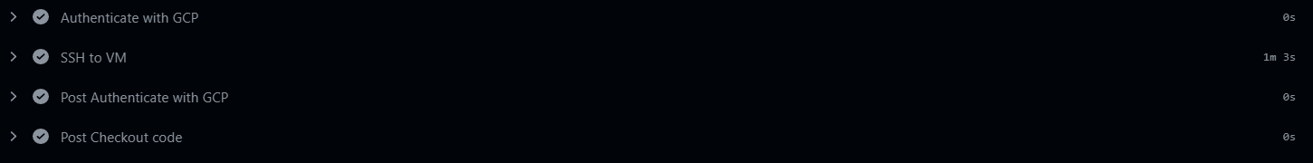
Testing Branch

Slide 8
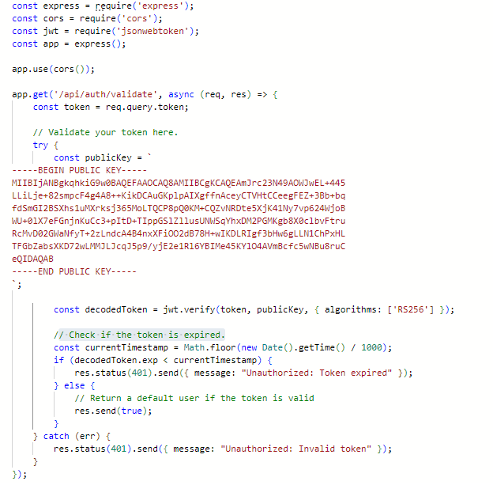
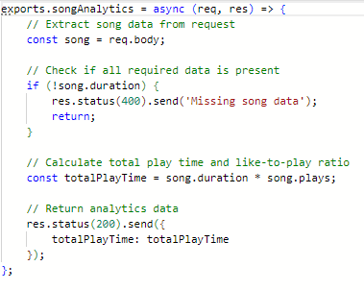
Serverless Functions
I am using two GCP serverless functions:
JWT Validator
Music Analytics
JWT Validator
Music Analytics

Slide 9
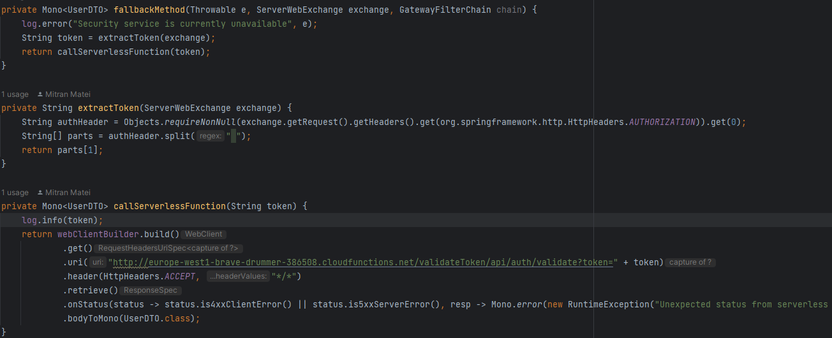
Circuit Breaker

Slide 10
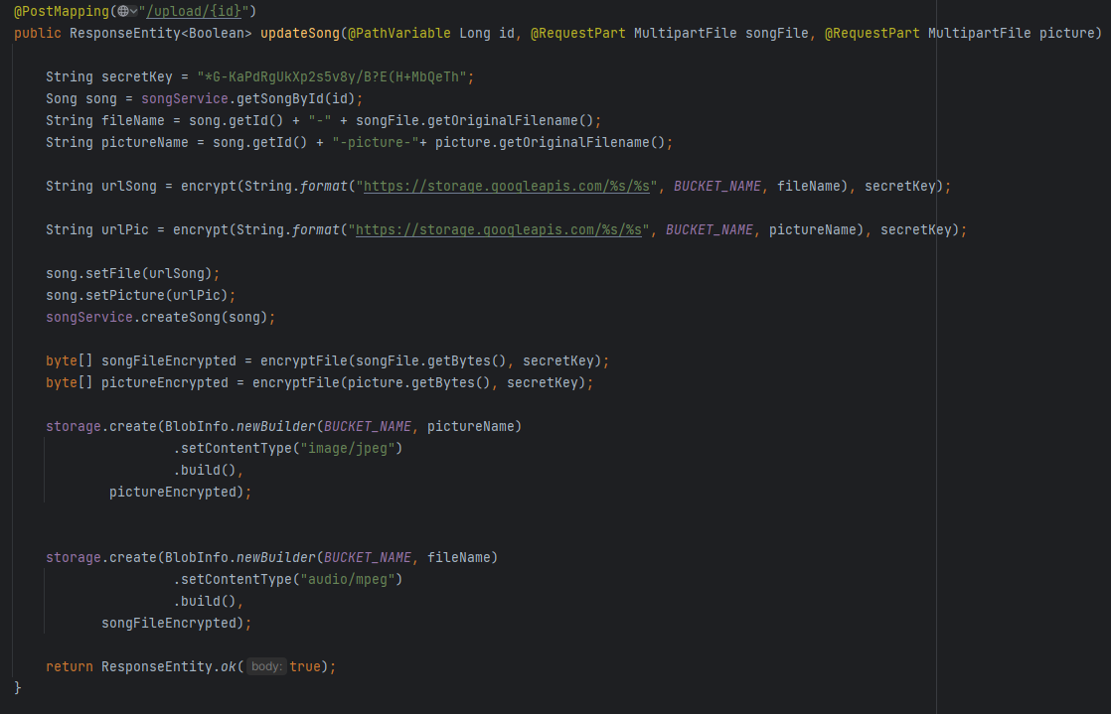
GCP Storage Bucket

Slide 11

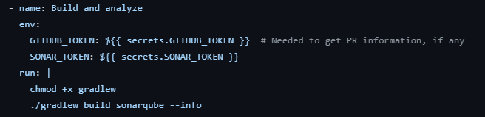
CI/CD Pipeline

Slide 12
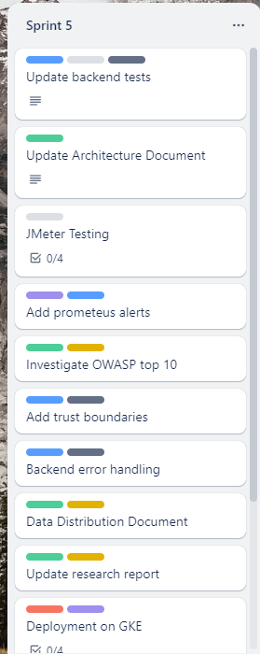
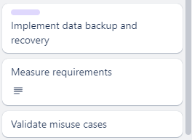
Next
Steps

